Slide 1


ASCEND!
High Altitude Balloon Launch

Slide 2
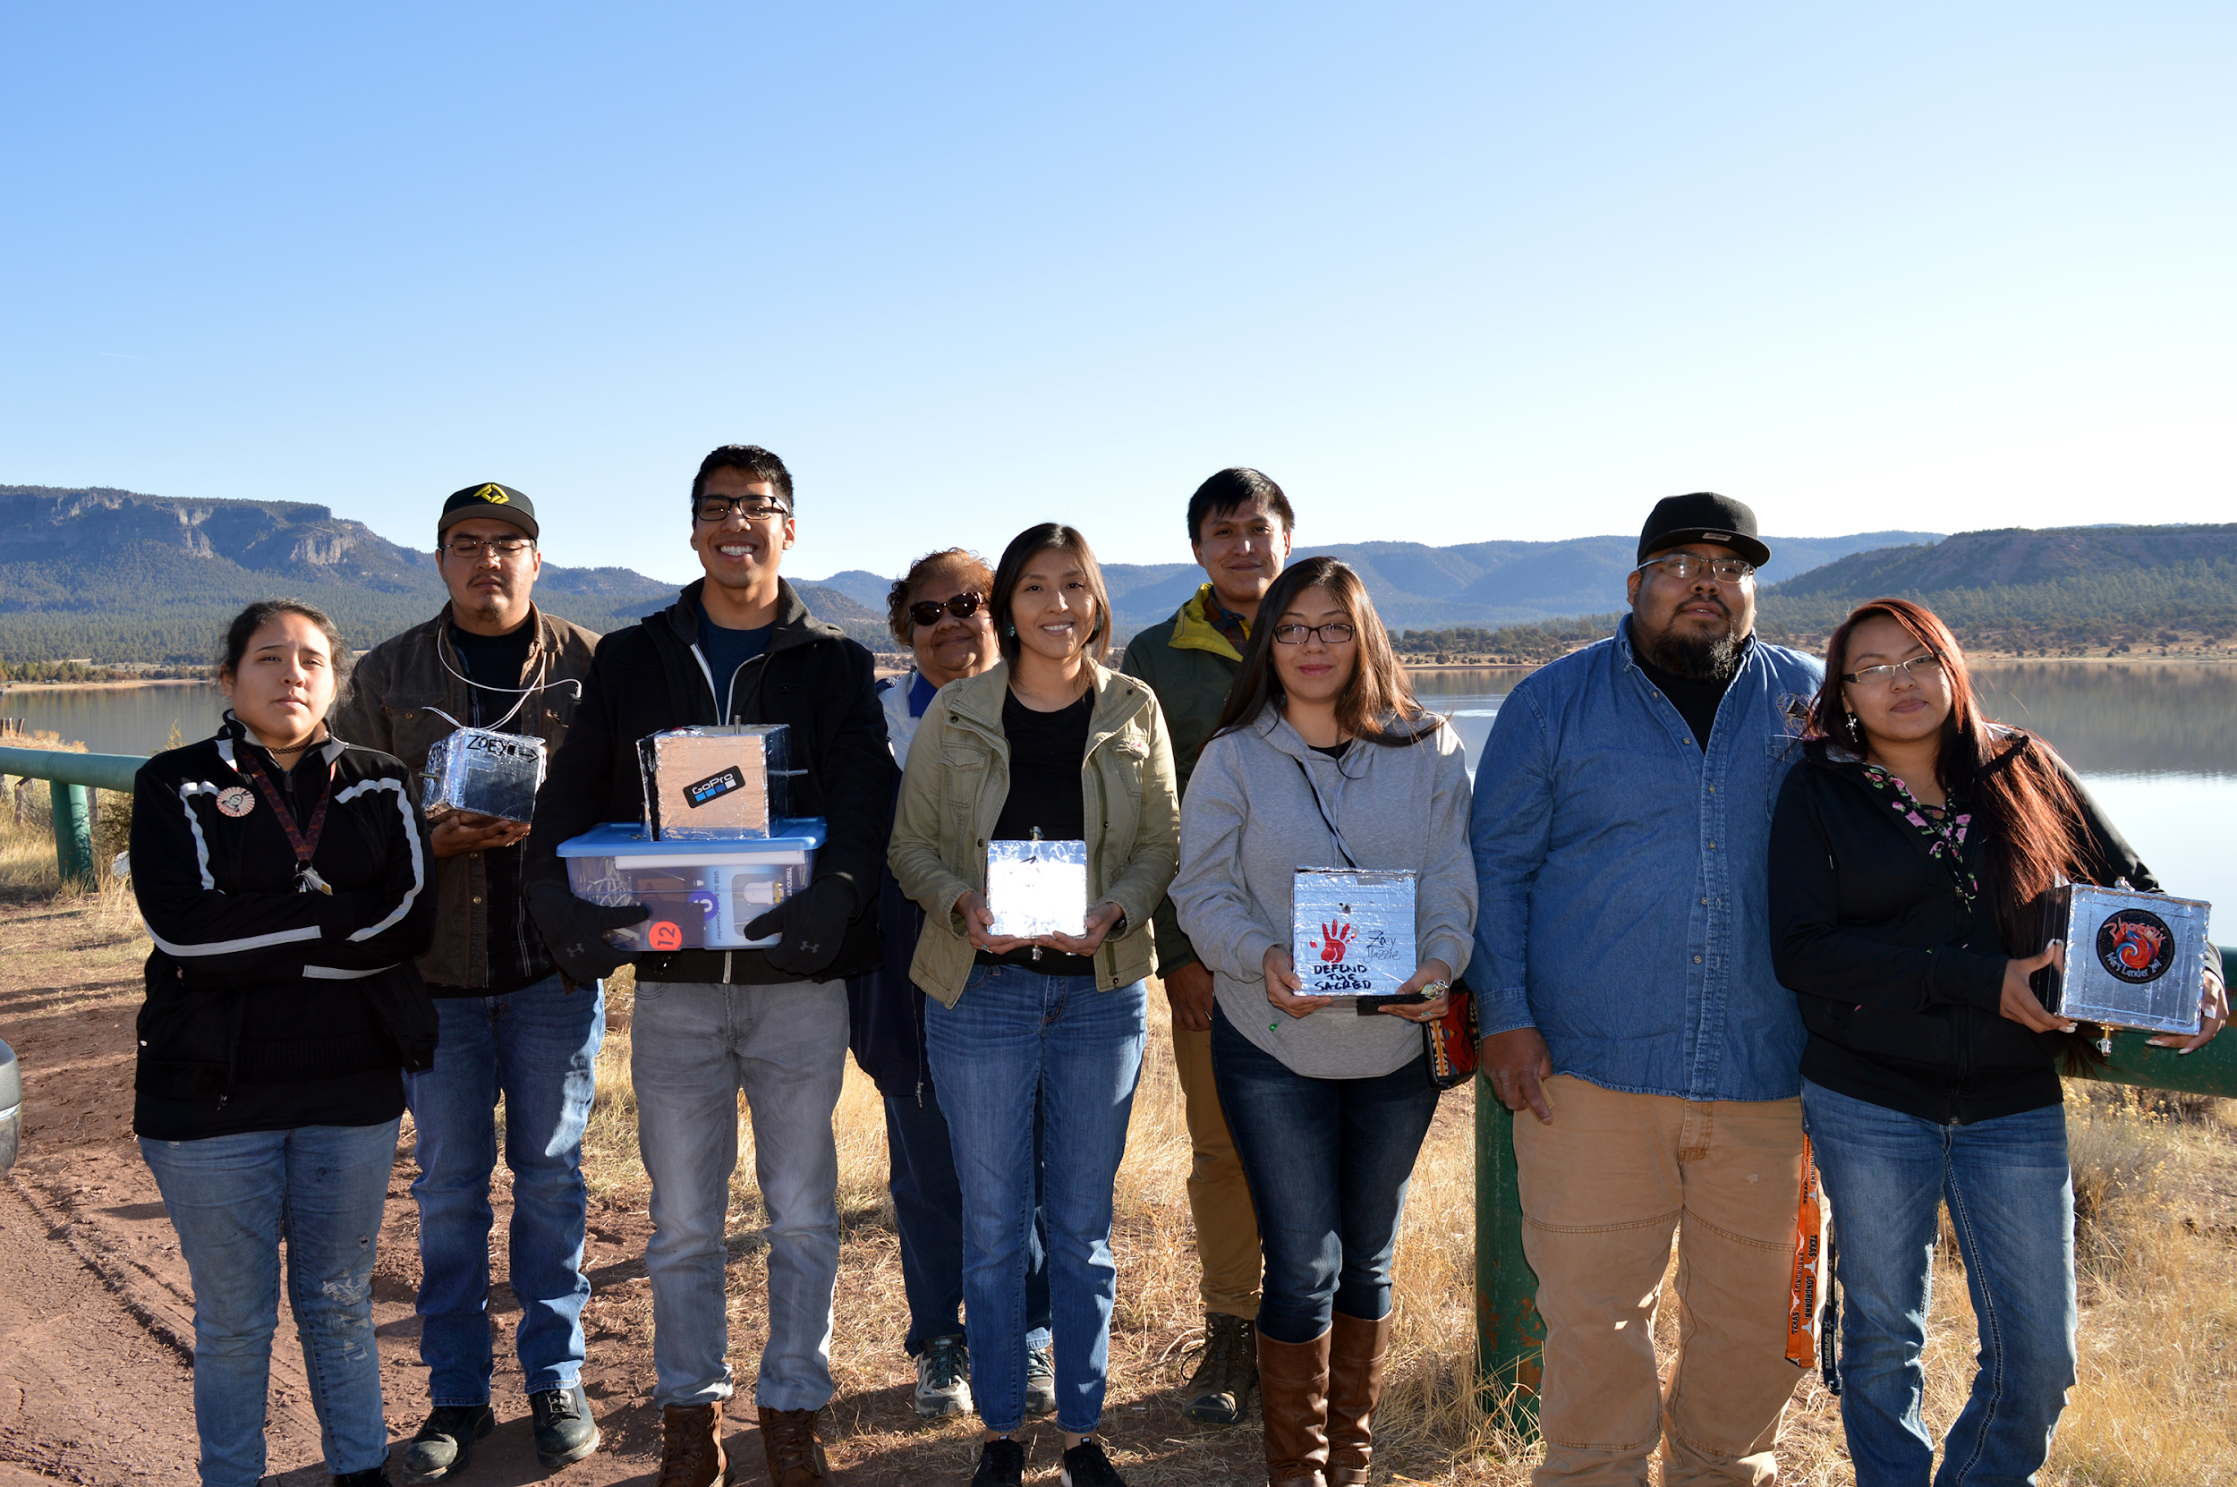
ASCEND! Interns
Byron C. Shorty - Associates of Science in Pre-Engineering
Cordell R. Chee - Bachelors of Science in Biology
Jamie J. Begay - Associates of Arts in Liberal Arts
Kyle S. Goh - Associates of Science in Pre-Engineering
Lynshell Begay - Associates of Science in Environmental Science
Shawn D. Laughter - Associates of Science in Environmental Science
Stephanie Moses - Associates of Science in Health Occupation
Zachary O. Beaver - Associates of Arts in Diné Studies
Zoey D. Yazzie - Associates of Arts in Liberal Arts
Advisor - Juanita Francis, Faculty, Diné College

Slide 3
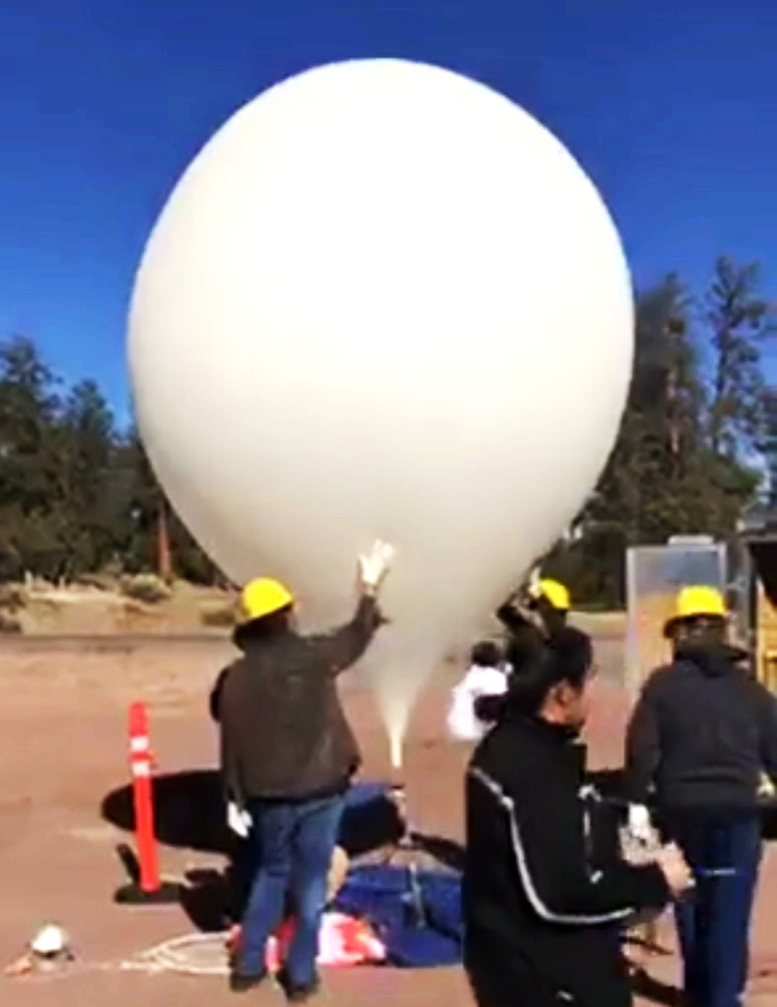
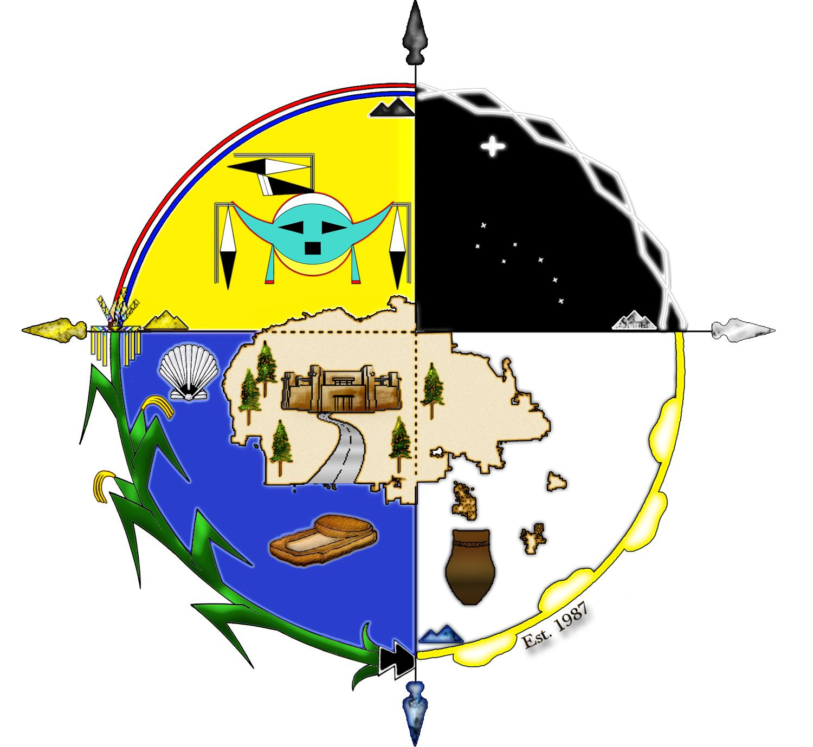
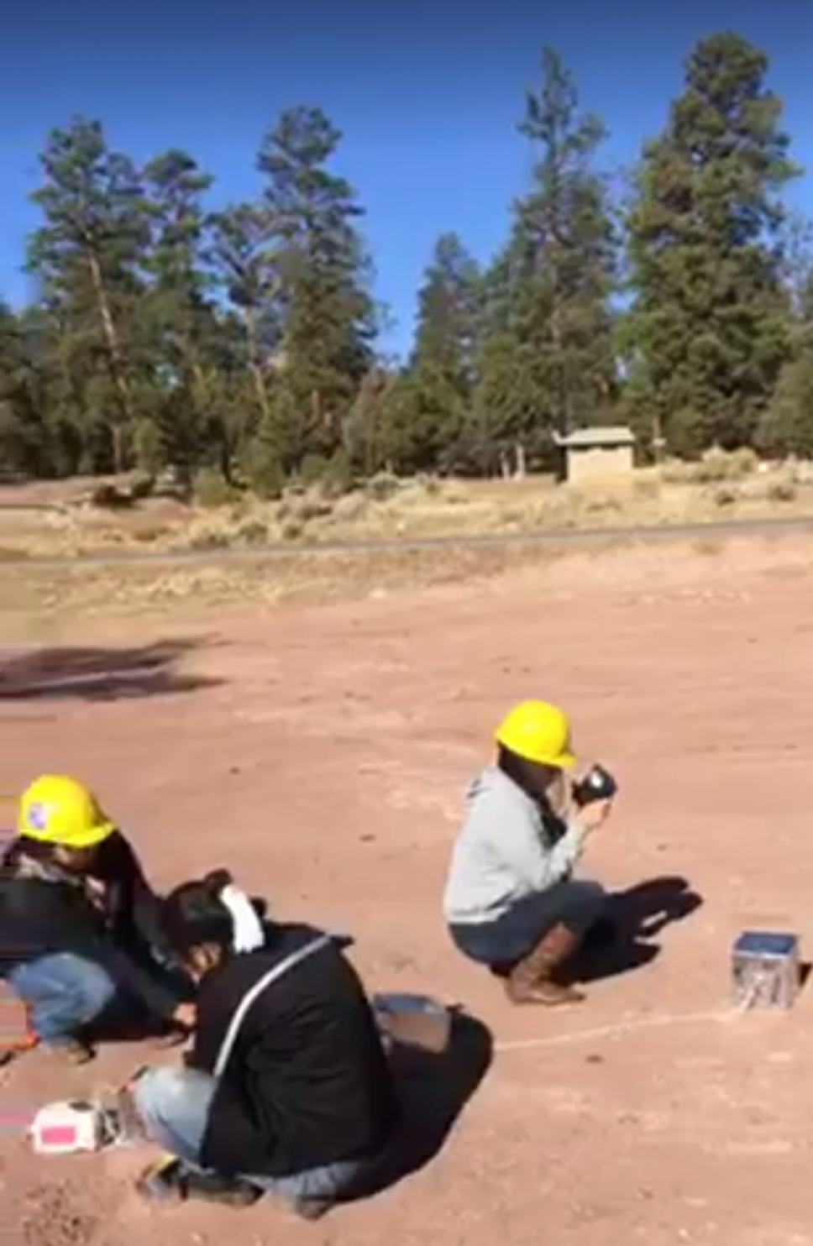
Diné (Navajo) Perspective
From the Navajo perspective, the Air is a Gift of Life and must be treated with respect. “Air is the first thing we breathe when we enter this world and it will be the last thing we take as we leave this world.”
Our educational philosophy at Diné College is “Sa'ah Naagháí Bik'eh Hózóón”, the Diné traditional living system that places Diné life in harmony with the natural world and the universe.
We also apply four major concepts: Nitsáhákees (Thinking), Nahat'á (Planning), Iiná (Living) and Sihasin (Assuring).

Slide 4
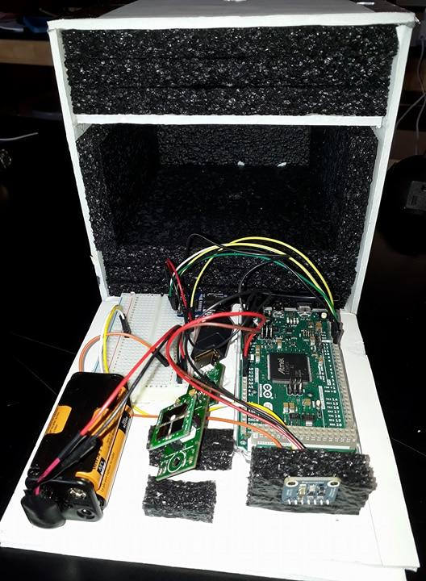
Sulfur Dioxide and Barometer
Due to technical difficulties, such as programming the Sulfur Dioxide sensor to communicate with the Arduino Due (the microcontroller board) we were unable to collect any data relating to Sulfur dioxide.
Data Collected:
Highest altitude: 91,369 feet (~17.4 miles)
Lowest temperature: -47 ̊C (-52.6 F)
Future Goals:
Additional programming and testing to have a successful 2019 ASCEND Launch

Slide 5
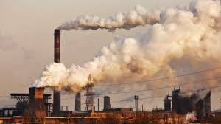
The correlation between Sulfur Dioxide and Atmospheric Pressure...
Sulfur dioxide (SO2) is an atmospheric pollutant that causes respiratory disease in young children and elders.
About 99% of the SO2 in air is anthropogenic.
Causes: industrial activity that processes materials containing sulfur, like fossil fuels and coal.
The Navajo Nation is has four major coal burning power plants, and a great number of homes use coal as a heat source during winter.
Goal: Is there a greater concentration of SO2 at low atmospheric pressure or at higher atmospheric pressure.

Slide 6
Nitrogen Dioxide in Relation to the Navajo Nation
~Nitrogen Dioxide (NO2) is an atmospheric pollutant that causes long term respiratory inflammation permanently damaging the lungs and increases vulnerability to respiratory illnesses.
~The presence of NO2 also contributes to the formation and modification of other air pollutants, such as ozone, acid rain, and other particulates as well an increase of hospitalization on the Navajo Nation.
~Common anthropogenic sources of NO2 is the combustion of fossil fuels.
Power Plants Household items Vehicle Emissions
Combustion Engines Off-Road Equipment Gardening Appliances
Fossil Fuell Burning Industrial Locations Wood Burning

Slide 7
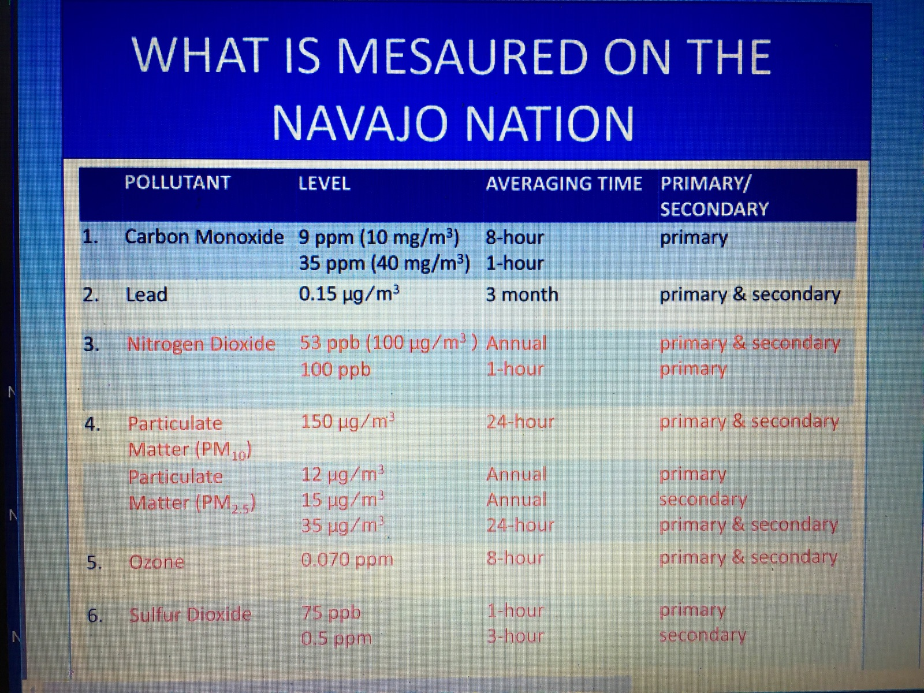
The Toxicological Evidence of NO2 Contamination on the Navajo Reservation
~How are pollutants measured?
~ What is ppb/ppm?
~How can the community help to lower these rates?
Source: Navajo Nation Air Quality Control Program Air Monitoring (2016-2017) www.navajonationepa.org/airquality (website)

Slide 8
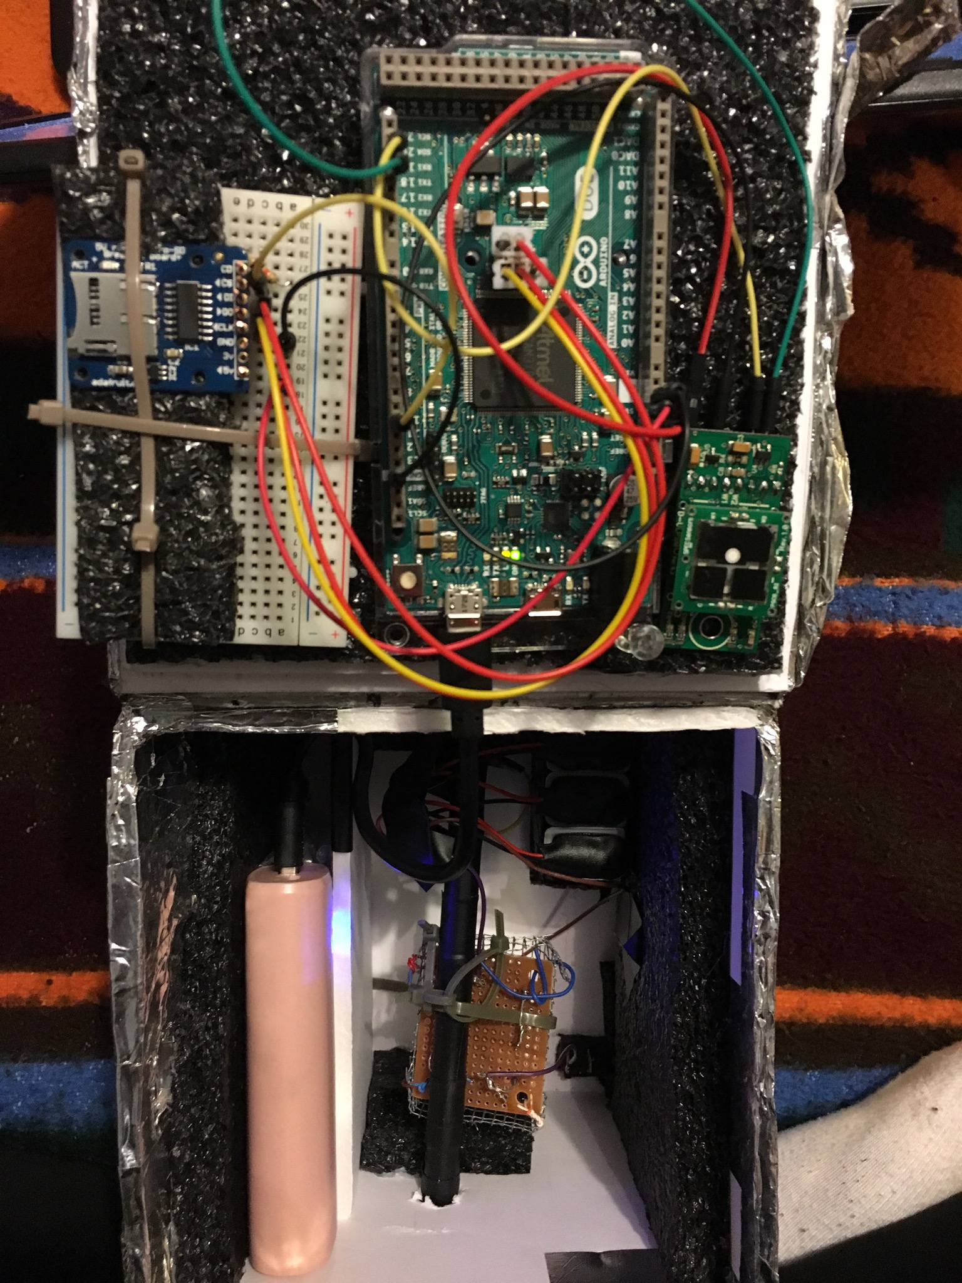
Nitrogen Dioxide Sensor
~ Goals were to obtain evidence and levels of Nitrogen Dioxide in the atmosphere over the Chuska Mountains as a sample in relation to the Navajo Nation overall.
~ Experience and research has prepared us to inform the public as well as the surrounding communities with crucial facts and numbers to reverse or contain current NO2 Levels from exceeding to hazardous levels.

Slide 9
Ozone on the Navajo Nation
What is O3 and what causes it?
Is it harmful?
How does it affect the Navajo reservation?

Slide 10
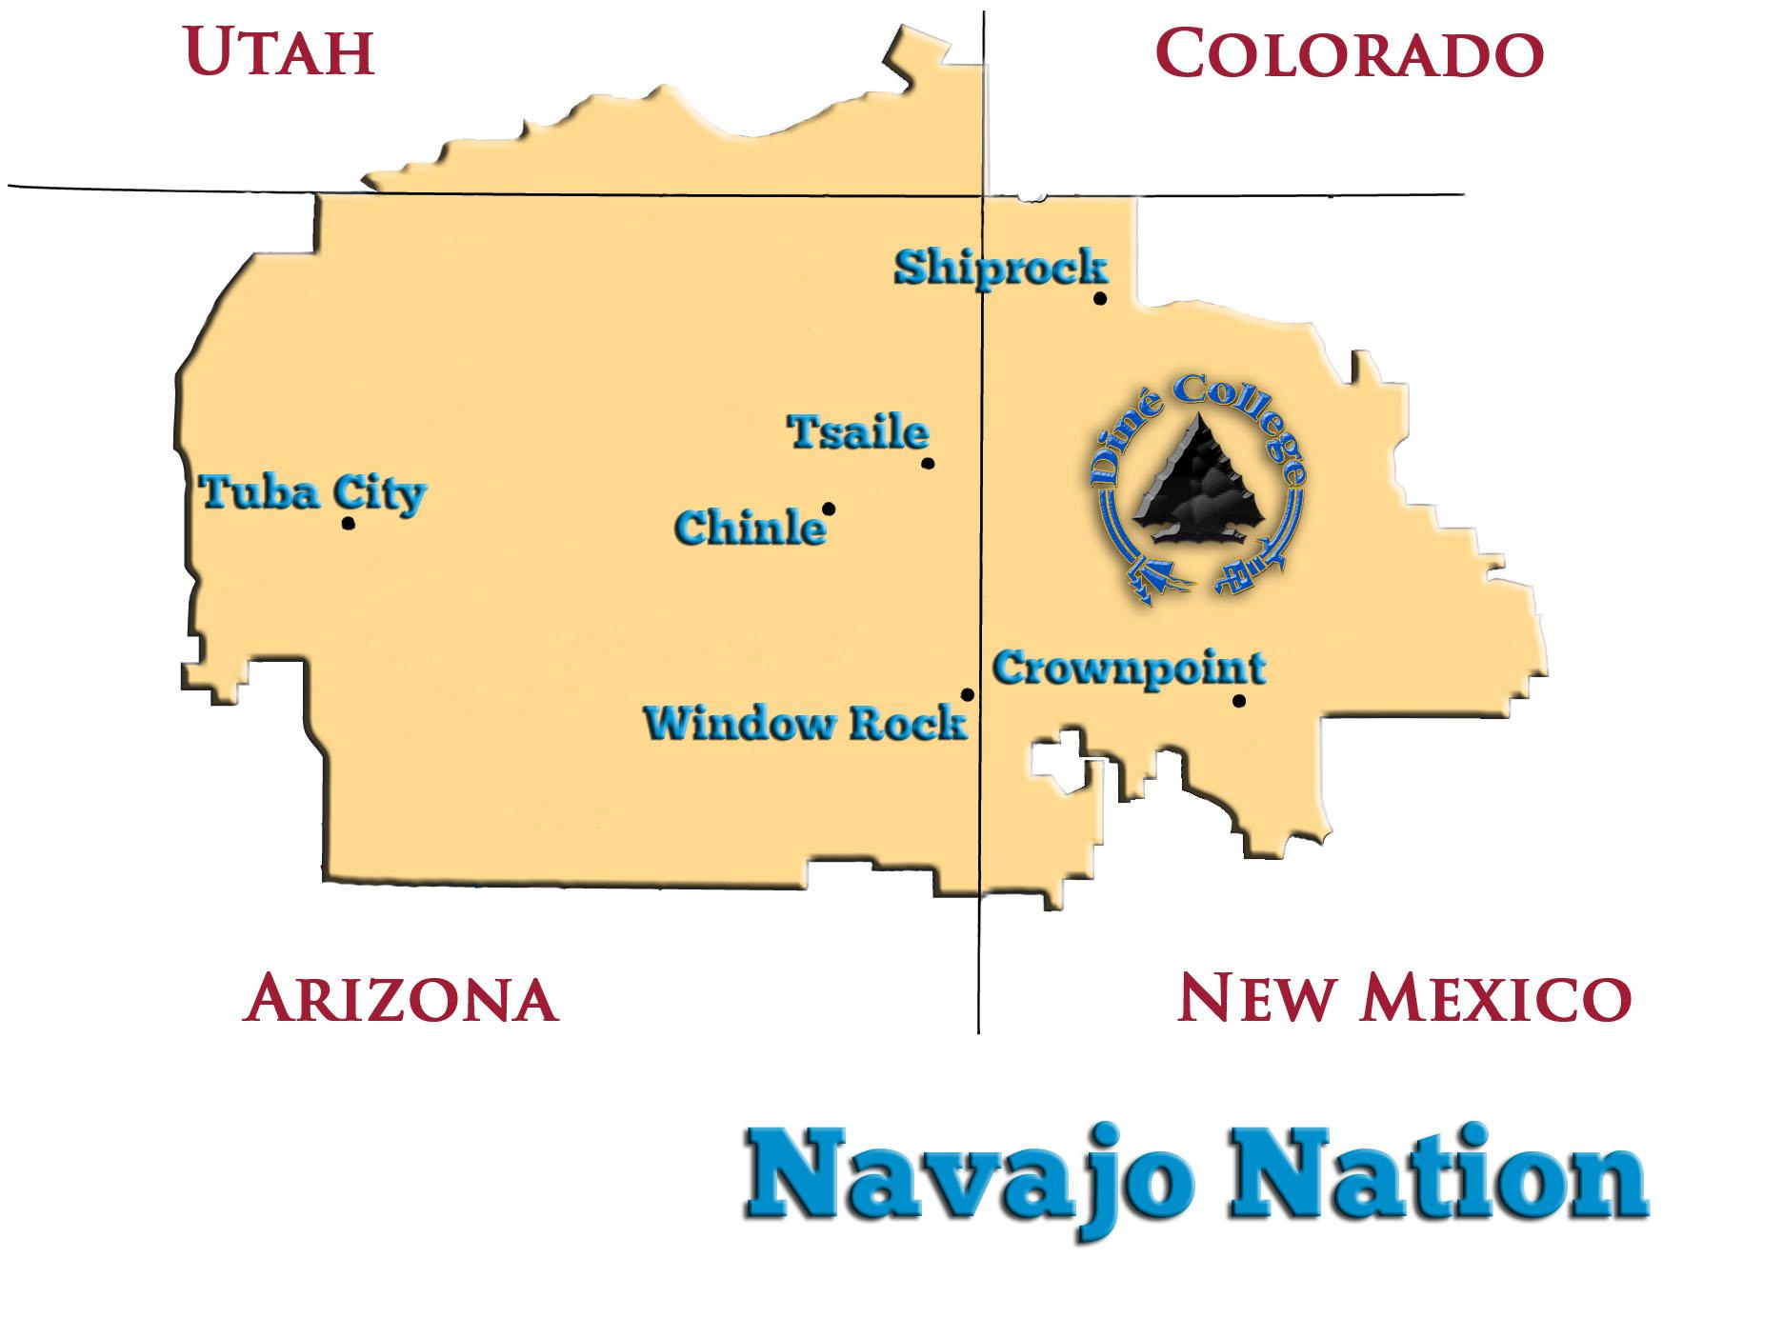
During the month of March 2018, our group took ozone measurements throughout the Navajo reservation.

Slide 11
March 2018 - Average O3
32.24 ppb
@ 7,142’
42.30 ppb
@ 6,350’
Piñon
Salina Springs
39.63 ppb
@ 6,830’
34.81 ppb
@ 5,928’
39.65 ppb
@ 5,506’

Slide 12
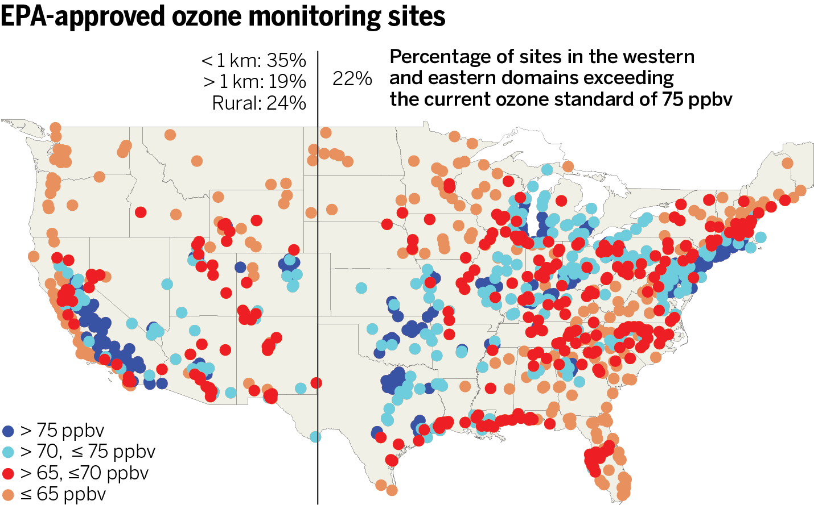
How does this correlate to the rest of America?
U.S. ozone-monitoring sites between 2011 and 2013. Dark blue dots show sites that did not comply with the health-based federal standard of 75 parts per billion (ppb). Credit: Map: O. Cooper et al., Science

Slide 13
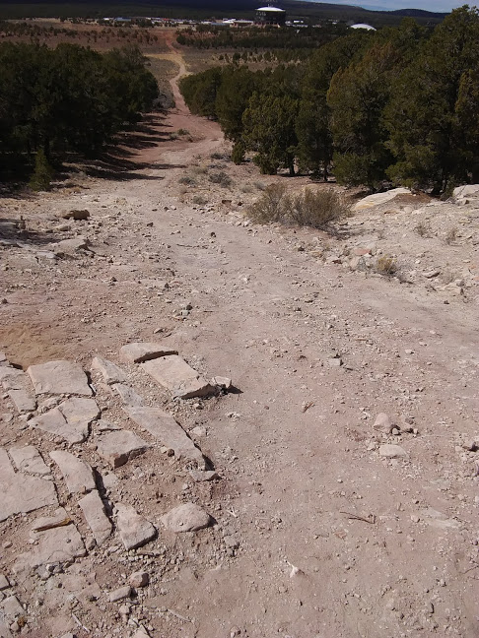
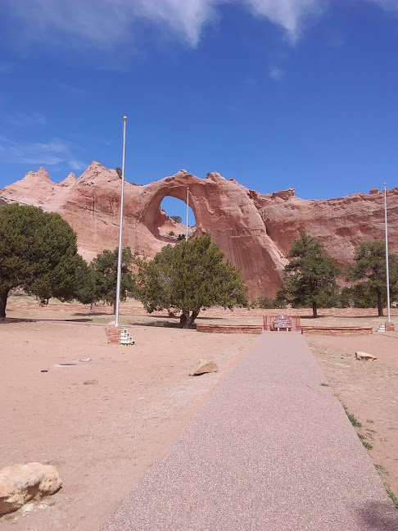
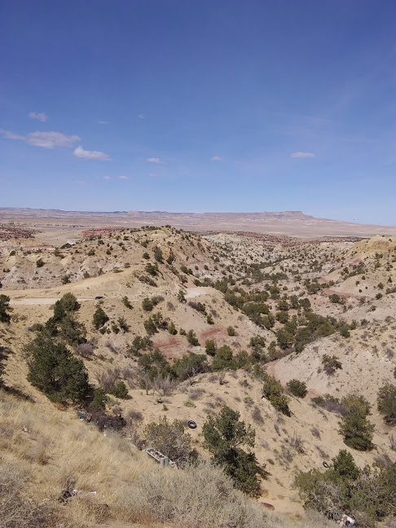
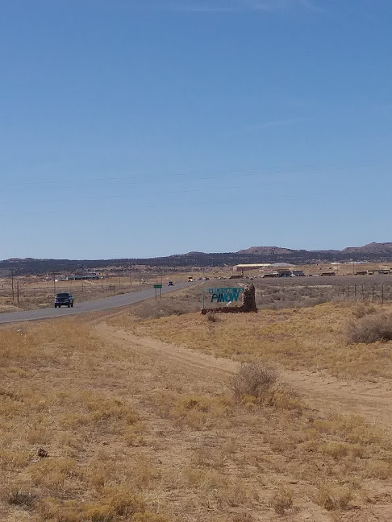
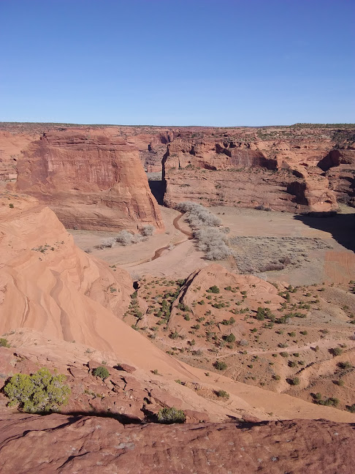
Conclusion
Tsaile, AZ
Window Rock, AZ
Salina Springs, AZ
Piñon, AZ
Chinle, AZ

Slide 14
Carbon Dioxide
Carbon Dioxide is an important greenhouse gas which helps in trapping heat into our atmosphere.
Elevated levels of Carbon Dioxide, are trapping more heat in the atmosphere, causing the Earth’s temperature to rise in what is known as Global Warming.
What levels of Carbon Dioxide within the Navajo Nation?
What effects are it causing?

Slide 15
Radiation and Its Effects on the Navajo Nation Environment
What types of radiation exist in the air?
How does this correlate to the environment?
What are the effects of radiation on the human body?
How is this related to pollution and climate change?

Slide 16
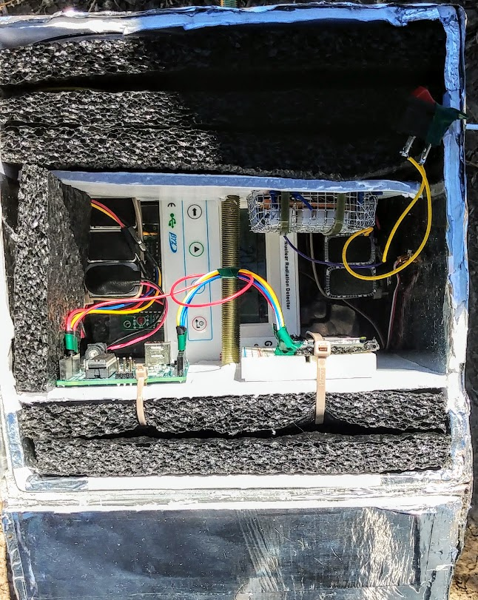
Incoming Radiation
Solar radiation is radiated energy emitted from the sun and it is perpetually a renewable energy.
The incoming radiation can be reflected by ice caps, clouds, and the surface of Earth but global warming affects the surfaces of reflection due to anthropogenic activities.
Causes: Infrared radiation can be reflected but due to a thick layer of greenhouse gases, the radiation can become entrapped, raising the temperature of the Earth.
Goal: Monitor the incoming radiation to detect which part of the atmosphere solar radiation is strongest..

Slide 17
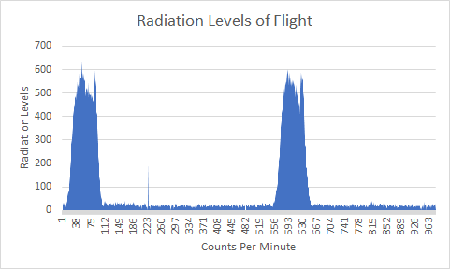
During the course of the flight, the ascending payload was able to measure the levels of radiation in the atmosphere.

Slide 18
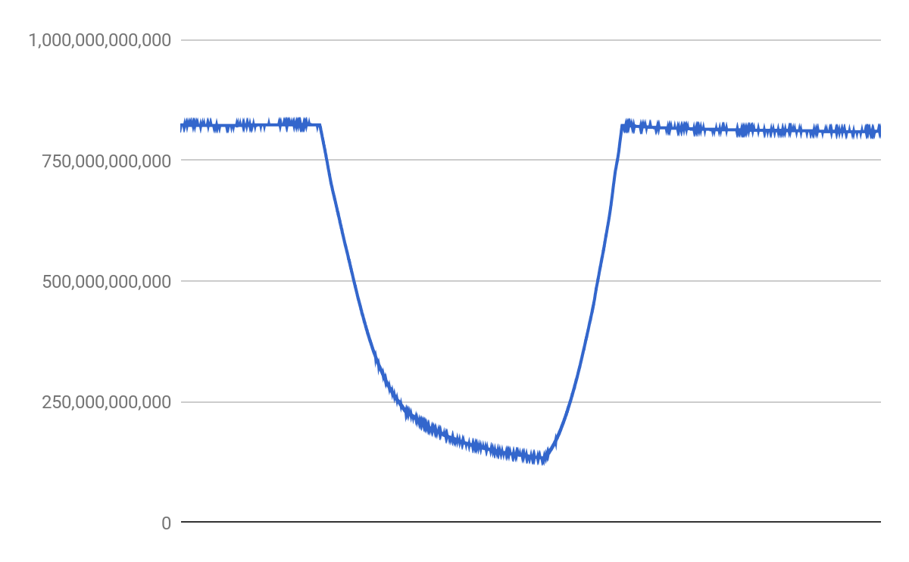
Temperature

Slide 19


Construction of Payloads
The objective of our ASCEND project was to conduct an aerial investigation of the contaminants in the atmosphere above the Navajo Nation.
During construction of the payloads, we had to program sensors to the Arduino Uno/Due boards and initiate tests to ensure our sensors would be able to perform.
During the flight, a majority of the payloads received data but we did not secure our SD cards (singular components) enough. The G-force during the flight may have affected the data log, therefore only a selected few payloads were able to retrieve atmospheric data.

Slide 20
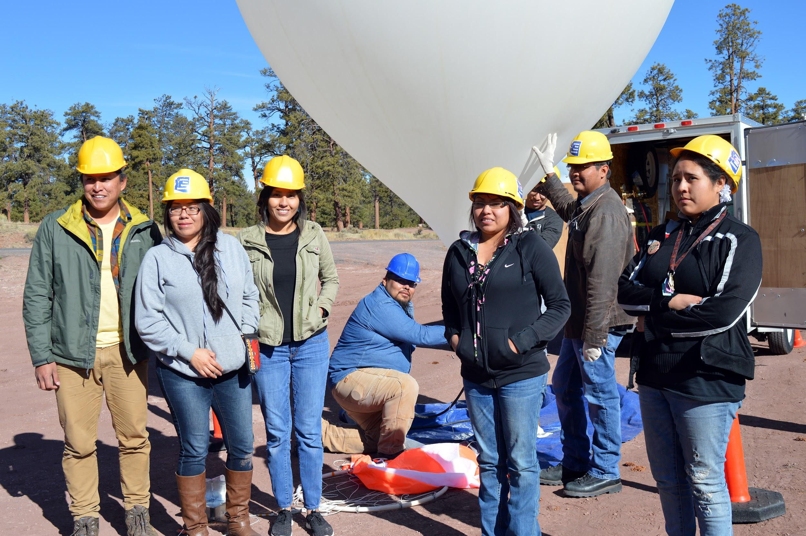
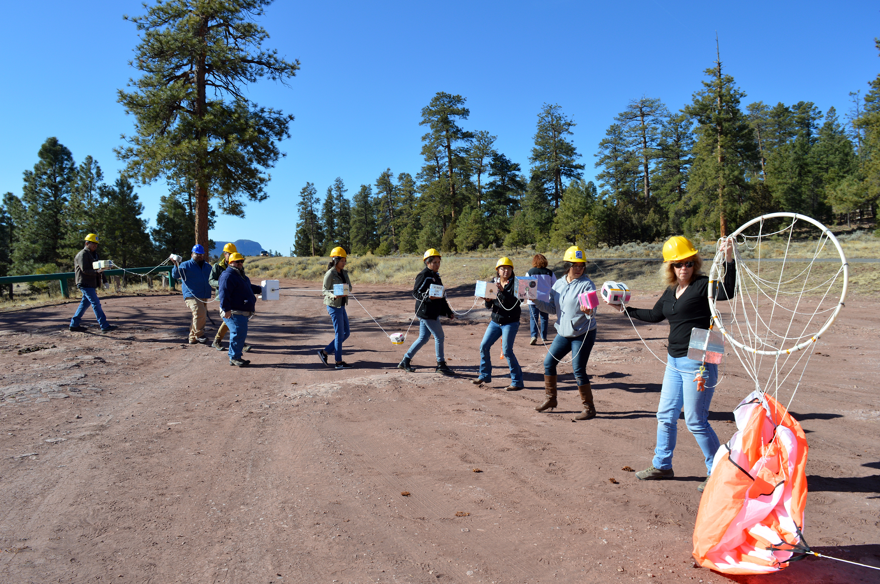
Photo: Team picture at launch

Slide 21

Ahéhee’ (Thank You)!
Dr. Juanita Francis, Diné College
Dr. Velma Hale, Diné College
Harry Walters, Diné Hatááłii
Dr. David Peaslee, Spec-Sensor Technician
Kathleen Stigmon, Northern Arizona University
Amy Gladwin, University of Arizona (& ANSR)
Paul Ranquillo, Phoenix Community College & Arizona State University
Diné College
Arizona Near Space Research launch and recovery team
Arizona Space Grant Consortium

